Slide 1
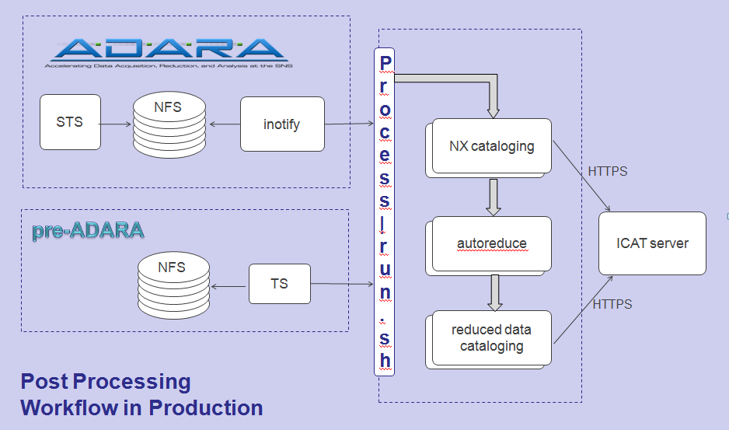

Automated Reduction
Data →Reduction→User Access→ ICAT
Details design, status & future direction
Poster Sessions

Slide 2
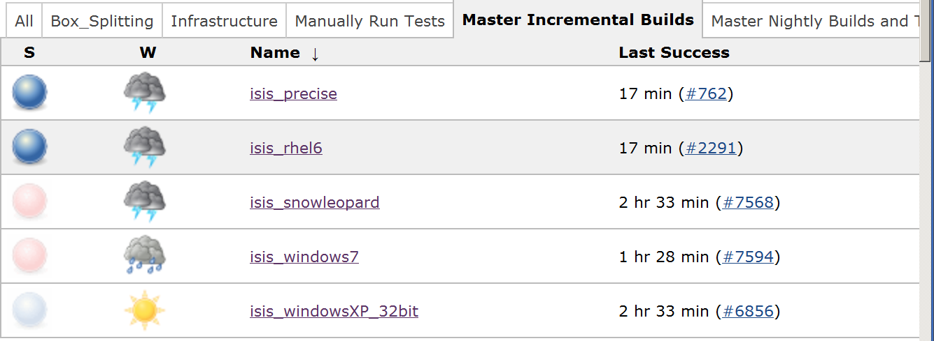
Continuous Build, Test & Deploy
Project lifecycle
Automated build environment
Ensuring software quality
Poster Sessions

Slide 3
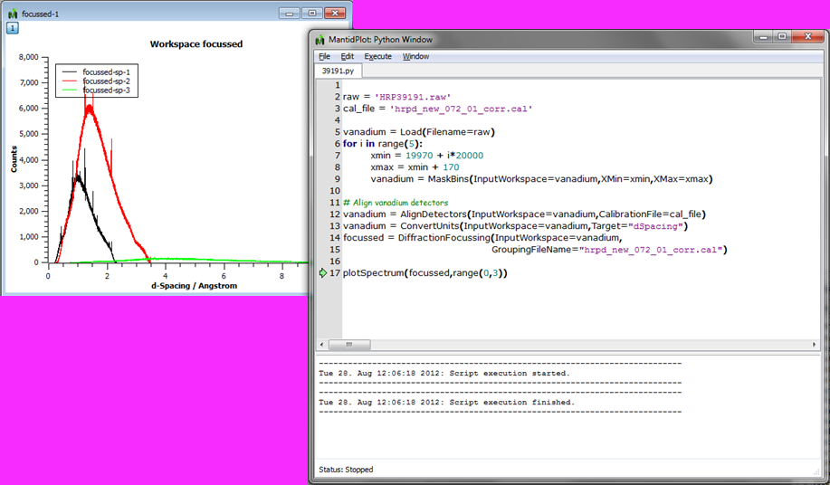
Deep Integration With Python
Exposing C++ framework to Python
Connecting with Numpy
Embedding IPython
Poster Sessions

Slide 4
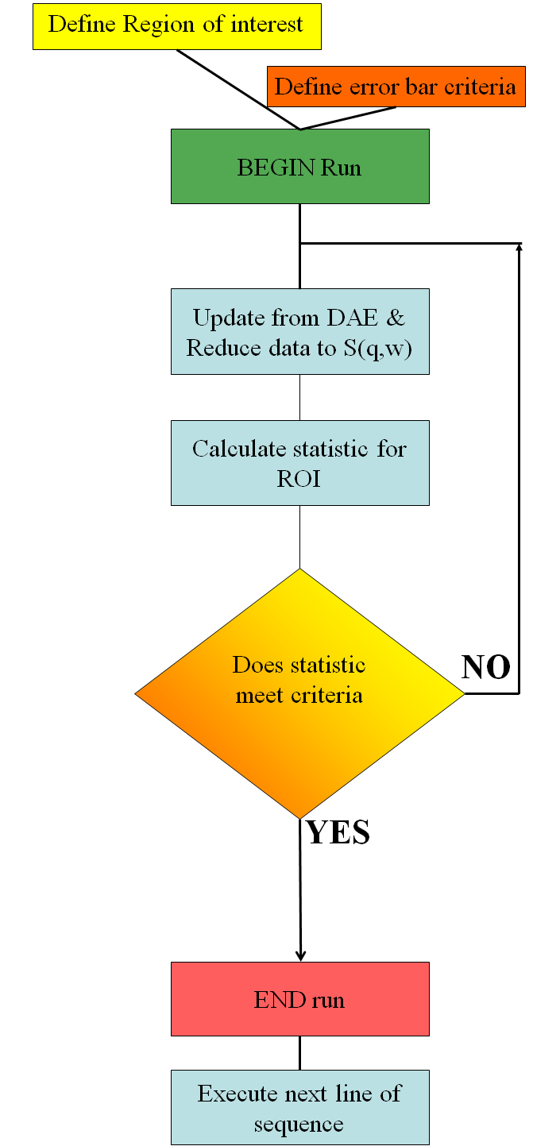
Linking Instrument Control And Data Analysis
Control ISIS Instruments with Mantid & PyGenie
Intelligent run control based on statistics
Poster Sessions

Slide 5
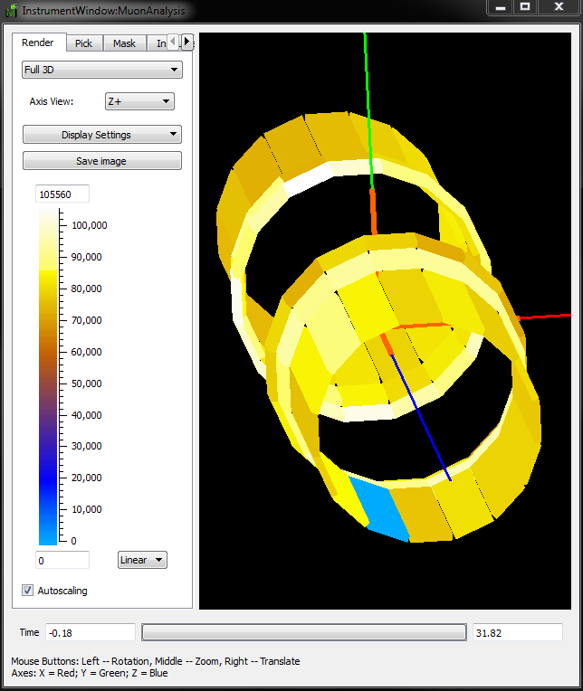
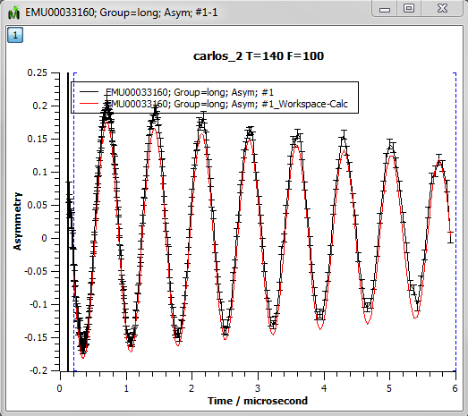
Mantid as a tool for MUSR analysis
MUSR uses muons → Mantid is not restricted to neutron data
GUIs to easily perform common muon related tasks
Poster Sessions

Slide 6
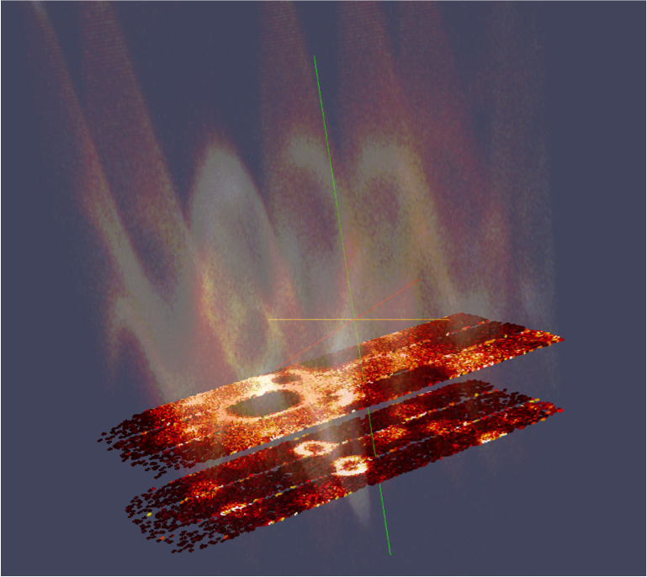
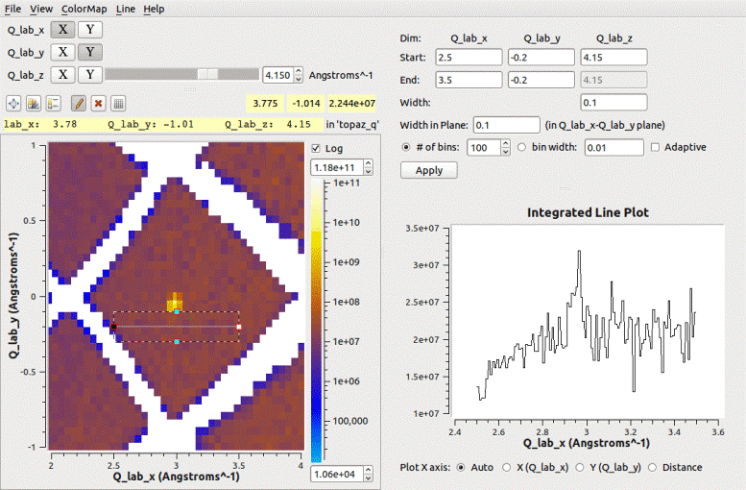
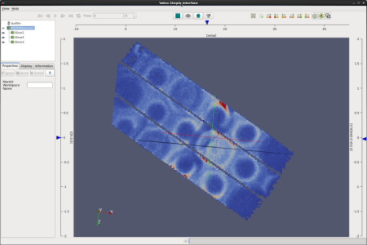
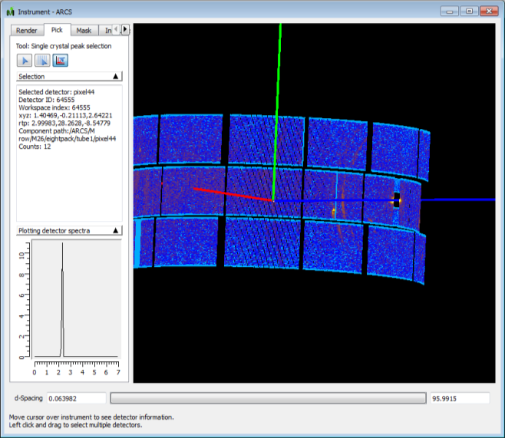
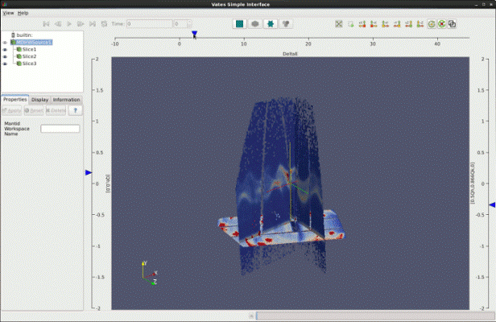
Data reduction and visualization at SNS and HFIR
Overview of use of Mantid at SNS & HFIR
Poster Sessions

Slide 7

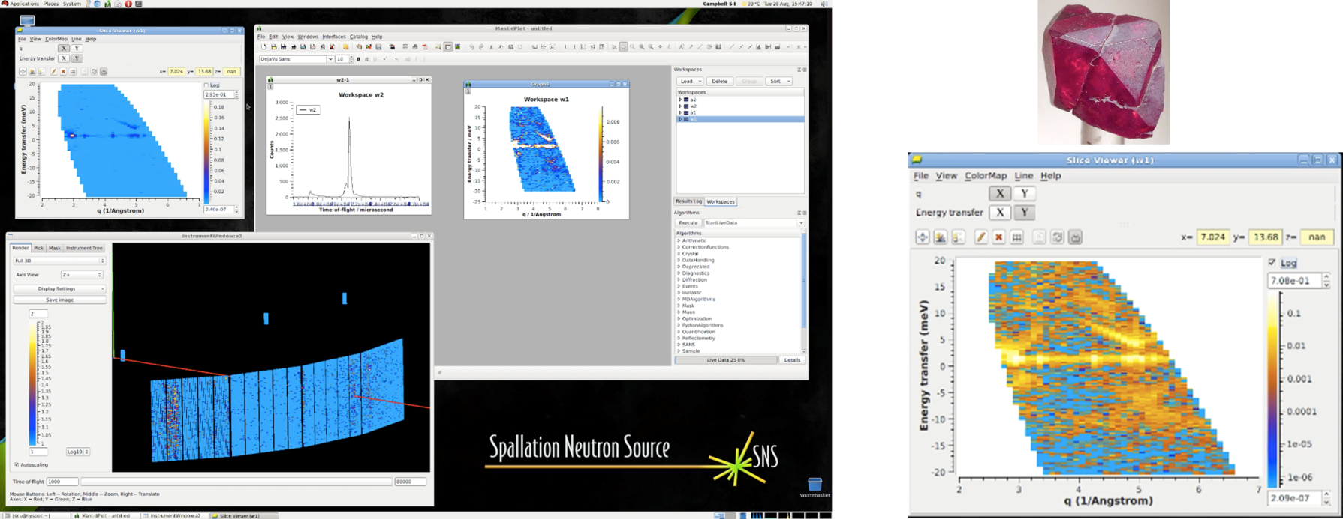
Streaming & Processing of Data In Real Time
Provide near real-time feedback to users as experiment continues
Integration with ADARA at SNS
Poster Sessions

